Slide 1


Advanced Asynchronicity
An Introduction to advanced patterns
JUDIT BARTHA
MARCH 24, 2020

Slide 2

Who am i?
PLEASE INSERT PHOTO HERE
Software Engineer at EPAM Systems
Working at EPAM since February 2018
JavaScript UI developer
Graduate of the University of Debrecen, Computer Science BSc
Please feel free to email to me at Judit_Bartha@epam.com

Slide 3
Agenda
1
Recap: Promises
2
Async/await
3
What is RxJS
4
What is functional programming
5
Using RxJS
6
Comparison with Promises
7
Examples of RxJS usecases

Slide 4

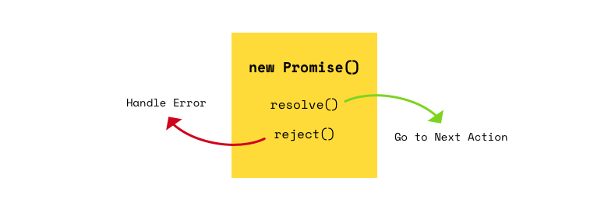
Promises: recap!

Slide 5
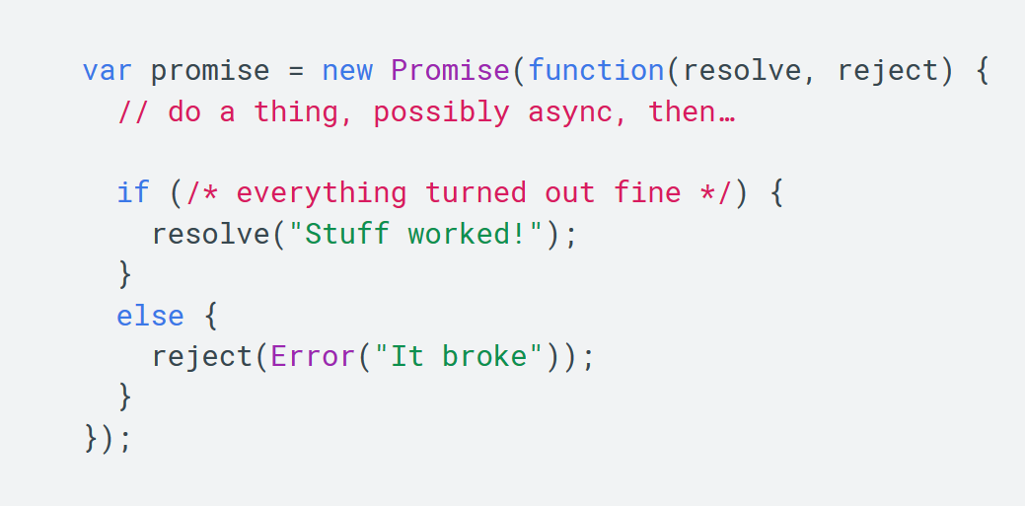
Promise syntax
📖 Documentation: Primer on Promises

Slide 6
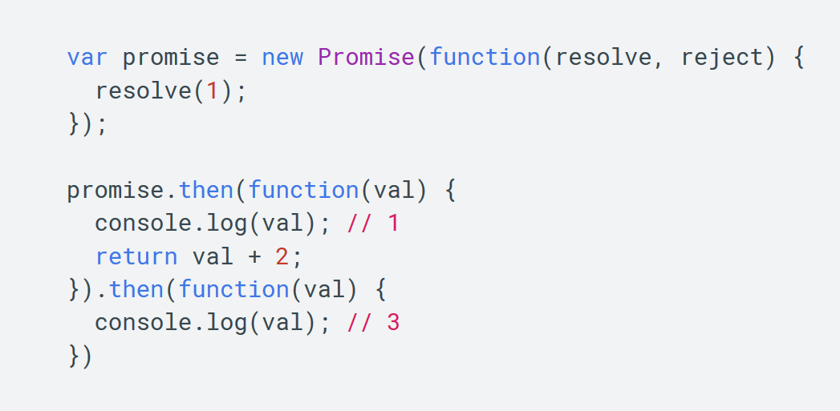
Promise chaining

Slide 7
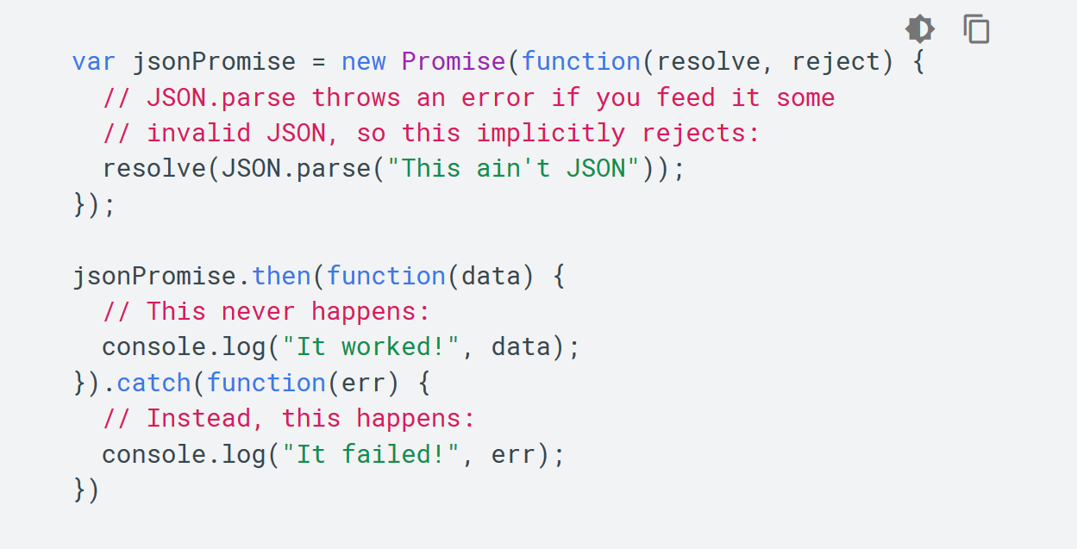
Error handling

Slide 8
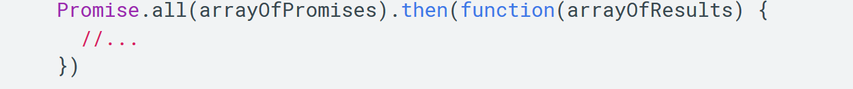
Working with multiple promises

Slide 9
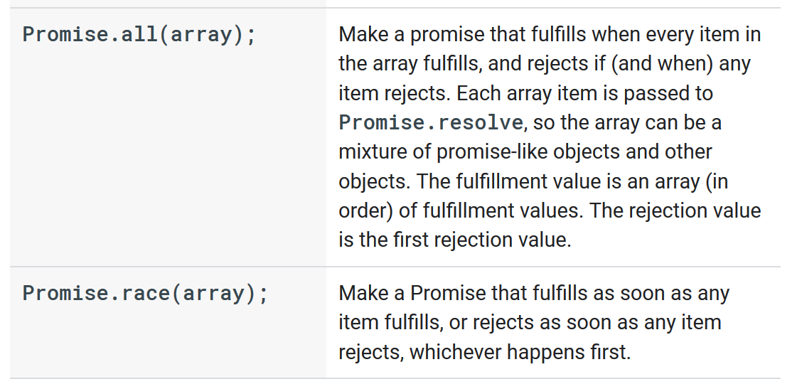
Working with multiple promises

Slide 10
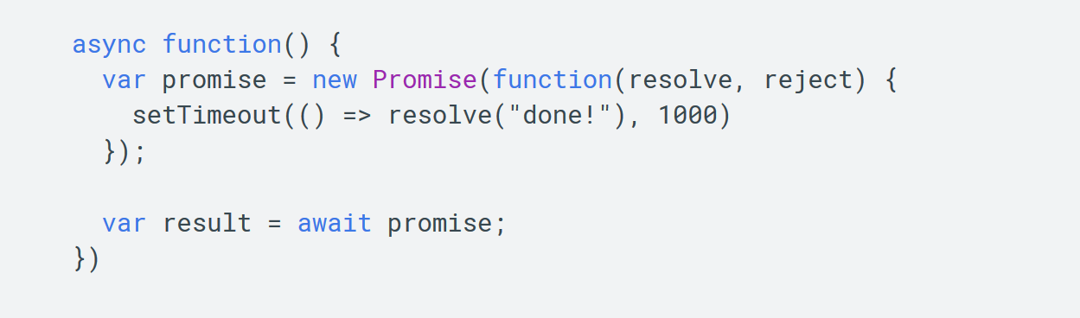
Async / await

Slide 11

RxJS: an introduction
What if there was another way?

Slide 12
What is RXJS?
RxJS is a library for reactive programming using Observables, to make it easier to compose asynchronous or callback-based code. It provides useful types:
Observable
Observer
Schedulers
Subjects
And operators inspired by Array#extras (map, filter, reduce, some) to allow handling asynchronous events as collections.
A tool for managing sequences of events.

Slide 13
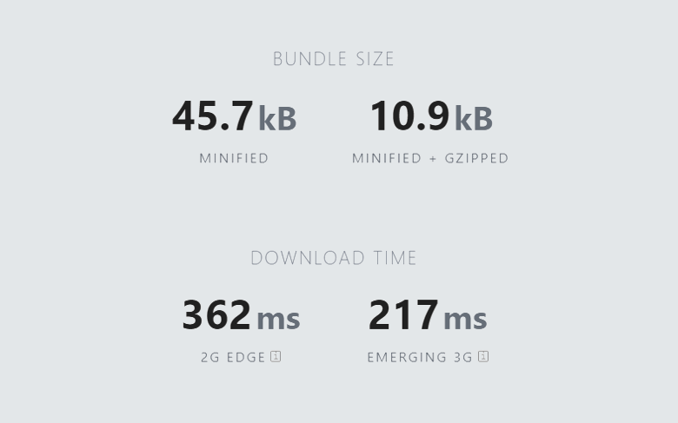
The cost of RxJS

Slide 14





Who is using RxJS?

Slide 15
ReactiveX is a combination of the best parts of the Observer pattern, the Iterator pattern and functional programming

Slide 16

Let’s break that down.

Slide 17
ReactiveX is a combination of the best parts of the Observer pattern, the Iterator pattern and functional programming

Slide 18
The Observer pattern is a software design
pattern in which an object, called the Subject,
maintains a list of its dependents, called Observers, and notifies them
automatically of any state changes
(usually by calling one of their methods).

Slide 19

Observer pattern in real life
We follow things everyday.
We can subscribe to channels or content feeds.
It’s entirely ubiquitous in our day-to-day life.
Every time you click a bell,
or follow someone, you
become their Observer.

Slide 20
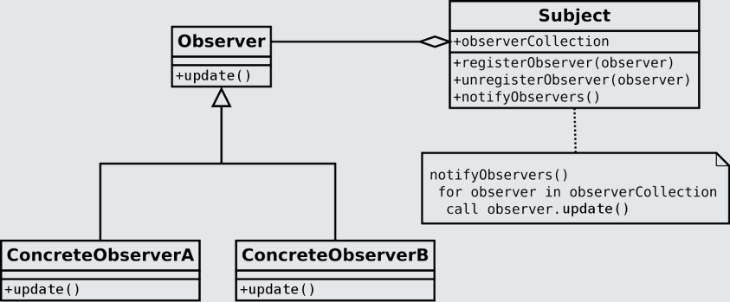
Observer pattern
📖 Documentation: Observer pattern

Slide 21
ReactiveX is a combination of the best parts of the Observer pattern, the Iterator pattern and functional programming

Slide 22
Definition Count: #3
The Iterator pattern provides a way to
access the elements of an object container
sequentially without exposing the underlying representation.

Slide 23
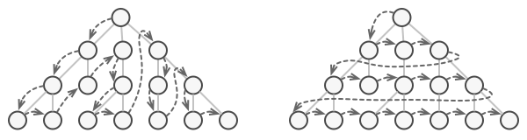
Iterator pattern examples
We often find that even if we know the underlying structure of some data (like this lovely tree here), we may have multiple ways of accessing its elements. Should we go depth-first or breadth-first? What do we call this operation?

Slide 24
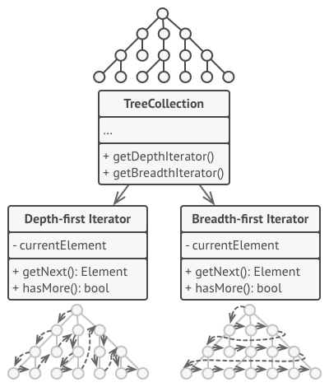
Iterator pattern
The Iterator Pattern comes to the rescue!
No matter the implementation behind it, it allows you easy access to every element in a data structure.

Slide 25
ReactiveX is a combination of the best parts of the Observer pattern, the Iterator pattern and functional programming

Slide 26
Definition Count: #4
Functional programming is a declarative
style of building software characterized by
using pure functions, and
avoiding side-effects and mutating data.

Slide 27
Pure functions
To be a pure function you must fulfil two criteria:
Same input, same output Every single time. E.g. the 100.000th execution must be identical to the first.
No side-effects No mutating variables outside the function scope, no logging, no writing to disk, no HTTP calls “Leave no trace.”
Increased testability. Easier debugging. Easier to understand.

Slide 28

Questions (break)

Slide 29
Pure functions
let x = 2;
const add1 = (y) => {
x += y;
};
add1(4); // 6
const add2 = (x, y) => x + y;
add2(2, 4); // 6
Notes:
Nehéz élete van a pure functionnek, nagyon kevés dolgot szabad tennie. És ez a slide extra fontos ezért serif betűtípússal van.

Slide 30
Pure functions
QUESTION TIME
let x = 2;
const add1 = (y) => {
x += y;
};
add1(4); // 6
Which function is pure?
add1
add2
What is the side-effect?
logging
mutating a variable
takes too long
const add2 = (x, y) => x + y;
add2(2, 4); // 6

Slide 31
Pure functions
QUESTION TIME
let x = 2;
const add1 = (y) => {
x += y;
};
add1(4); // 6
Which function is pure?
add1
add2
What is the side-effect?
logging
mutating a variable
takes too long
const add2 = (x, y) => x + y;
add2(2, 4); // 6

Slide 32
Definition Count: #5
Higher-order function is a function that fulfills at least one of the following:
takes one or more functions as arguments
returns a function as its result.
All other functions are first-order functions.

Slide 33
Higher-order functions (HOF)
function repeat(n, action) {
for (let i = 0; i < n; i++) {
action(i);
}
}
repeat(3, console.log);
const greaterThan = m => m > n;
let greaterThan10 = greaterThan(10);
console.log(greaterThan10(11)); // true

Slide 34
Higher-order functions
QUESTION TIME
function repeat(n, action) {
for (let i = 0; i < n; i++) {
action(i);
}
}
repeat(3, console.log);
Which of these answers are ALL HOFs?
repeat
repeat, greaterThan
greaterThan
const greaterThan = m => m > n;
let greaterThan10 = greaterThan(10);
console.log(greaterThan10(11)); // true
Is greaterThan10 a HOF?
true
false

Slide 35
Higher-order functions
QUESTION TIME
function repeat(n, action) {
for (let i = 0; i < n; i++) {
action(i);
}
}
repeat(3, console.log);
Which of these answers are ALL HOFs?
repeat
repeat, greaterThan
greaterThan
const greaterThan = m => m > n;
let greaterThan10 = greaterThan(10);
console.log(greaterThan10(11)); // true
Is greaterThan10 a HOF?
true
false

Slide 36
Higher-order functions you’ve seen before
const array = [1, 2, 3, 4];
const doubled = array.map(element => element * 2);
const double = n => n * 2
const doubled2 = array.map(double);
let newArray = []
for(let i = 0; n < array.length; i++) {
newArray[i] = array[i] * 2
}
newArray // [ 2, 4, 6, 8 ]

Slide 37
Higher-order functions you’ve seen before
QUESTION TIME
const array = [1, 2, 3, 4];
const double = n => n * 2
const doubled2 = array.map(double);
After executing the map function, does array still contain [1,2,3,4]?
true
false
Which of these answers are ALL HOFs?
double, map
double
map

Slide 38
Higher-order functions you’ve seen before
QUESTION TIME
const array = [1, 2, 3, 4];
const double = n => n * 2
const doubled2 = array.map(double);
After executing the map function, does array still contain [1,2,3,4]?
true
false
Which of these answers are ALL HOFs?
double, map
double
map

Slide 39
RxJS concepts
A tool for managing sequences of events.
What is a sequence?
Anything,
pretty much!

Slide 40
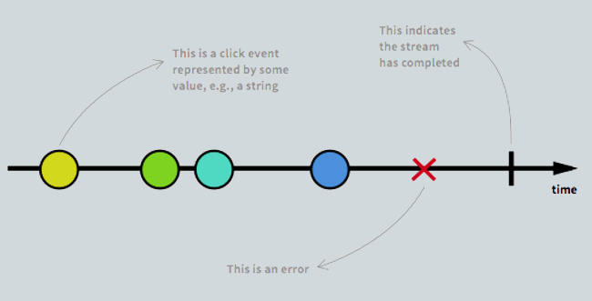
Okay, what do you mean by a sequence?
DOM events
Every click, hover, resize on an element or window
Ticks (from a timer)
Values of an array
responses from a server
function calls

Slide 41
How are sequences represented?
A stream is a sequence of ongoing events ordered in time.
At each emission we have three possible results
a value
an error
completed signal
What completed semantically means can differ, but it’s the point where the information is not relevant anymore e.g.
when a window containing a button is closed
when the user has logged out

Slide 42
Definition Count: #6
A Subject (or Observable) is the
stream which is being observed.

Slide 43
Definition Count: #7
An Observer is a callback function that
defines what to do when a value
arrives on the observable.

Slide 44
Definition Count: #8
You can subscribe to observables,
creating a Subscription. These can be
cancelled by unsubscribing.

Slide 45
Definition Count: #9
You can treat your observable like a
collection (like a an array) by using
operators. This can also be referred to
as piping the observable through the operator.

Slide 46
Concepts Recap
Subject or Observable
The stream which is being observed
Subjects are equivalent to EventEmitters (in fact the Angular 2 EventEmitter is a descendant of a Subject)
Observer
Callback function that defines what to do when a value arrives on the Observable
Subscription
Adding a “listener” the observable is achieved via subscribing, creating a subscription
Can be cancelled by unsubscribing from the observable
A single observable can have multiple subscriptions
Operators
pure functions that help can treat the stream of events like a collection
common variants are transforming, filtering, and aggregating the stream values

Slide 47
Observables are useless on their own
they don’t do anything until you subscribe to them.

Slide 48


Practical RxJS

Slide 49
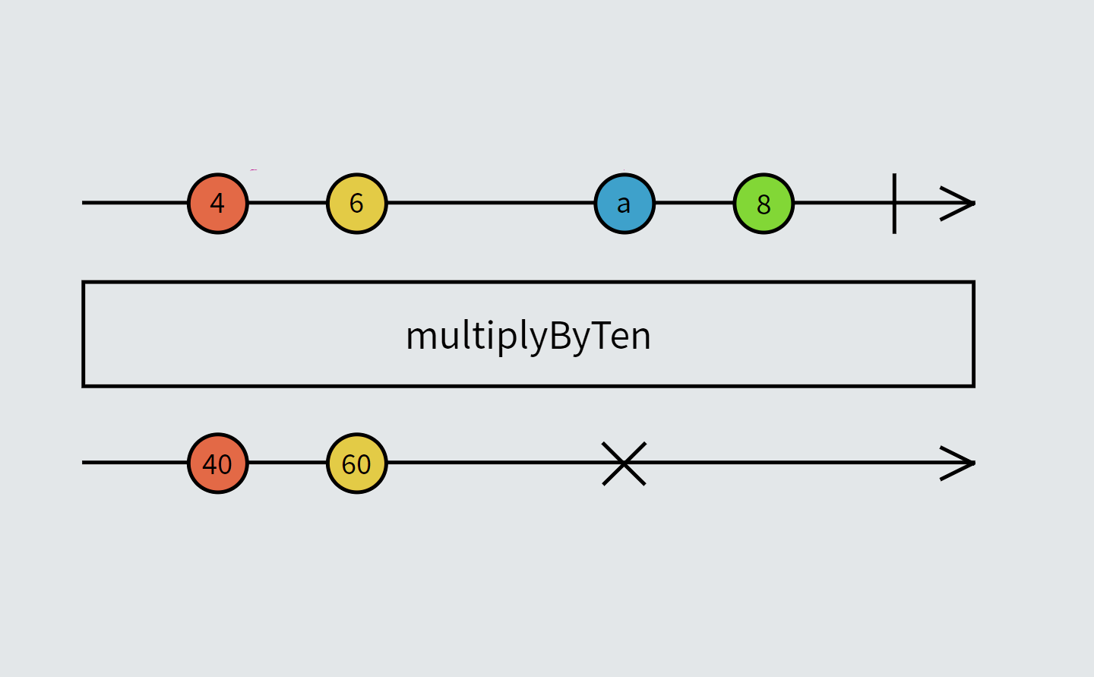
Concepts Recap
Creating observables
Basic operations
subscribing
unsubscribing
handling errors
tapping
filtering
mapping (transform)
Advanced operations
debouncing
merging
switching
Example of transforming a stream that can be achieved via map.

Slide 50
Creating Observables
Using the Observable Constructor
const observable = Observable.create( observer => {
observer.next( 'hello' )
observer.next( 'world' )
})
observable.subscribe(val => console.log(val))
// hello
// world
⭐ All examples can be found here

Slide 51
Creating Observables
Using of (a constant value)
We can create an observable from some static values. It completes immediately after emitting its values.
const stuff = of('anything', ['you', 'want'], 23, true, {cool: 'stuff'})
stuff.subscribe(val => console.log( val ))
// anything
// you,want
// 23
// true
// [object Object]

Slide 52
Creating Observables
Using from (a promise or a string or an array…)
const promise = new Promise((resolve, reject) => {
setTimeout(() => {
resolve('resolved!')
}, 1000)
});
const obsvPromise = from(promise)
obsvPromise.subscribe(result => console.log(result) )

Slide 53
Creating Observables
Using fromEvent
const clicks = fromEvent(document, 'click')
clicks.subscribe(click => console.log(click))
const box = document.querySelector('div.box');
const mouseoverBox = fromEvent(box, 'mouseover')
mouseoverBox.subscribe(() => console.log('Box hovered!'));
Notes:
Nehéz élete van a pure functionnek, nagyon kevés dolgot szabad tennie. És ez a slide extra fontos ezért serif betűtípússal van.

Slide 54
Creating Observables
Using timer and interval
const timer$ = timer(1000, 300);
const subscription = timer$.subscribe(
x => console.log(x)
);
const interval$ = interval(1000);
const subscription = interval$.subscribe(
x => console.log(x)
);

Slide 55
When an Observable is finished, it emits a complete notification.
You may need to stop them might flood the available memory.
Some observables complete automatically, but for others you must manually unsubscribe.

Slide 56
Combining subscriptions
Using Subscription.add()
const observable1 = interval(500);
const observable2 = interval(200);
//Subscribe to them
const subscription = observable1
.subscribe(x => console.log('obs1', x));
const childSubscription = observable2
.subscribe(x => console.log('obs2', x));
//Combine the second subscription with the first one
subscription.add(childSubscription);
⭐ Subscription examples

Slide 57
Basic operations
Using filter and map (with tap)
//Return the squared even numbers below 10
const numbers = of(1, 2, 3, 4, 5, 6, 7, 8, 9, 10);
const evensSquared = numbers.pipe(
tap(val => console.log(val)),
filter(num => num % 2 === 0), map(val => val * val)
)
evensSquared.subscribe(x => console.log(x));
Do these look familiar? It’s no surprise, these common RxJS utilities use the exact same names as some Collection operations.
Map and filter are obvious, tap is pretty much the forEach equivalent (“do something but don’t change the values”).
Notes:
Good, good, NOW we are DONE, and can get to the fun parts.

Slide 58
Basic operations
Aggregation using scan
const numbers = of(1, 2, 3, 4, 5, 6, 7, 8, 9, 10);
const isEven = val => val % 2 === 0;
const evens = numbers.pipe(filter(isEven));
//keep a running total of the number of even numbers
const evenCount = evens.pipe(scan((acc, _) => acc + 1, 0));
evenCount.subscribe(val => console.log(val));
Doesn’t seem familiar? Scan is very closely related to Array#reduce and much of the same logic can be implemented with it.
⭐ Basic operation examples

Slide 59
Basic operations: unsubscribing
Using unsubscribe
const observable = of(1, 2, 3);
const subscription = observable
.subscribe(val => console.log(val));
subscription.unsubscribe();

Slide 60
Basic operations: unsubscribing
Using take
const interval$ = interval(500);
interval$.pipe(
take(2)
).subscribe(val => console.log(val));

Slide 61
Basic operations: unsubscribing
Using takeUntil (an observable emits a value)
const evenCount = evens.pipe(scan((acc, _) => acc + 1, 0));
//do not emit until 5 even numbers have been emitted
const fiveEvenNumbers = evenCount.pipe(filter(val => val > 5));
const example = evens.pipe(
map(val => `Even number ${val}`),
//after five even numbers have been emitted, complete source observable
takeUntil(fiveEvenNumbers)
);
example.subscribe(val =>
console.log(`Taking until 5 values: ${val}`));
⭐ Complex example
Notes:
Good, good, NOW we are DONE, and can get to the fun parts.

Slide 62
Basic operations
Handling errors
//an observable that emits an error
const source = throwError('This is an error!');
//gracefully handle error
//returning observable with error message
const example = source.pipe(
catchError(val => of(`I caught: ${val}`))
);
example.subscribe(val => console.log(val));

Slide 63
Basic operations
Keep distinct values with distinctUntilChanged
const source$ = from([1, 1, 2, 2, 3, 3]);
// output distinct values, based on the last emitted value
source$
.pipe(distinctUntilChanged())
// output: 1,2,3
.subscribe(console.log);
Notes:
Good, good, NOW we are DONE, and can get to the fun parts.

Slide 64
Advanced operations
Combine observables using merge
//emit every 2.5 seconds
const first = interval(2500);
//emit every 1 second
const second = interval(1000);
const example = first.pipe(
merge(second)
);
//output: 0,1,0,2....
const subscribe = example.subscribe(val => console.log(val));
⭐ Advanced operation examples

Slide 65
Advanced operations
Debounce values with debounceTime
const keyup$ = fromEvent(searchBox, 'keyup');
// wait .5s between inputs to emit current value
keyup$
.pipe(
map((e) => e.currentTarget.value), //event object
debounceTime(500)
).subscribe(console.log);
Notes:
Good, good, NOW we are DONE, and can get to the fun parts.

Slide 66
Advanced operations
Switch between observables using switchMap
//When you want to switch from one observable to another
fromEvent(document, 'click')
.pipe(
// restart counter on every click
switchMap(() => interval(1000))
)
.subscribe(console.log); //Do something with the amount of seconds between clicks
SwitchMap has a couple of relatives such as MergeMap and ExhaustMap. The differences between these are an advanced topic, but in general it’s recommended to use SwitchMap when you are unsure or still learning.
Notes:
Good, good, NOW we are DONE, and can get to the fun parts.

Slide 67
Observables are useless on their own they don’t do anything until you subscribe to them.
I lied.
;_;
Cold observables need you to subscribe to them,
Hot observables can live on their own.

Slide 68

Hot and Cold
Cold Observables start emitting or creating values only when there is a subscription to them.
Like a video, it won’t start unless you press “play”. What this means is that data producer is created by the observable itself.
Observables created using the of, from, range, interval and timer operators will be cold. The data is created from within the observable itself, and there truly is not data being produced until the observable is subscribed to.
📖 Article on Hot n' Cold Observables

Slide 69

Hot and Cold
Hot Observables are always being updated with new values, much like a live stream. When you subscribe you start with the most recent value and only see new changes.
This means that you can have subscriptions that see completely different values, just like you can miss the beginning of a broadcast.

Slide 70
Hot and Cold examples
Cold observable
const obs$ = from([1, 2, 3]);
//Exactly the same output
const sub1 = obs$.subscribe(val => console.log('From sub1:', val));
const sub2 = obs$.subscribe(val => console.log('From sub2:', val));
Hot observable
const clickPos$ = fromEvent(document, 'click').pipe(
map(event => ({ clientX: event.clientX, clientY: event.clientY })));
const subs = clickPos$.subscribe(val => console.log('Sub1:', val));
setTimeout(() => {//Subscribe after 4 seconds
console.log('Start sub2');
subs.add(clickPos$.subscribe(val => console.log('Sub2:', val)));
}, 4000);
//The two subscriptions can differ if clicks happen in the first 4 secs

Slide 71
Useful links
Visualize how observable values look over time rxmarbles.com
For examples on how to use, recipes, and good documentation learnrxjs.io

Slide 72
Homework
Fork your own version of the wiki search we created during the presentation. Feel free to tackle any of these tasks as only task 3 is dependent on 2. Any other ideas to improve the search experience are also welcome!
Limit the visible search results to a configurable value.
While a search is loading write a “Loading…” text in the total search results field.
Modify the current behavior to have working links to the articles (that open the relevant wiki article).
Add some debounce to the input changes (generally 300ms is a safe bet) so that we limit the number of API calls we make.
Create a search history field (a simple unordered list will do) where you add each clicked result but clicking the same result twice in a row shouldn’t be added to the history.
Create your own search using a public API!
You can find the version that doesn’t use RxJS here.

Slide 73
Q & A
Thank you very much for your attention!
Judit_Bartha@epam.com

